Slide 1
North Africa

Slide 2
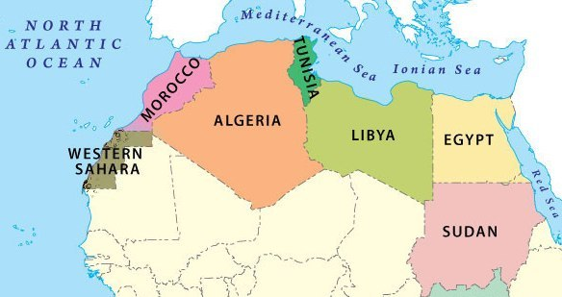

Slide 3
-Countries of North Africa: Algeria, Egypt, Morocco, Western Sahara, Sudan, and Tunisia

Slide 4
Ancient Egypt
-Empire spanned 2,600 years
-The Nile River was crucial to life in Egypt
-Flooded at the same time every year
-Provided water for both people and crops

Slide 5
Ancient Egypt
-Pharaohs, who ruled the empire during the Middle Kingdom, were known as “god-kings”
-Ancient Egyptians believed pharaohs ruled even after death

Slide 6
Ancient Egypt
-Ancient Egyptians are known for their farming techniques
-Used geometry to set boundaries after the Nile’s annual flood
-Also known for their medical techniques
-Created splints for broken bones
-Travel and trade along the Nile helped spread these practices

Slide 7
Economy of North Africa
-Oil is a very important commodity in Algeria, Libya, and Tunisia
-Consists of 99% of Libya’s exports
-Despite the prominence of the oil industry, many North Africans migrate to Europe in search of work

Slide 8
Culture of North Africa
-Muslim invaders from southwest Asia brought their language (Arabic), religion (Islam), and culture to North Africa
-Islam is the religious and cultural influence of North Africa

Slide 9
Culture of North Africa
-souks: marketplaces common throughout North Africa
-Bargaining for prices is very common
-Items for sale include clothing, spices, and traditional food like couscous

Slide 10
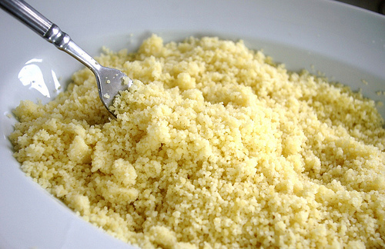


Slide 11
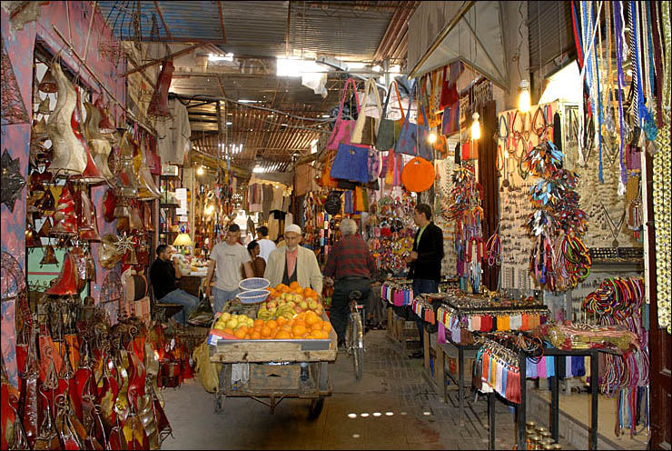

Slide 12
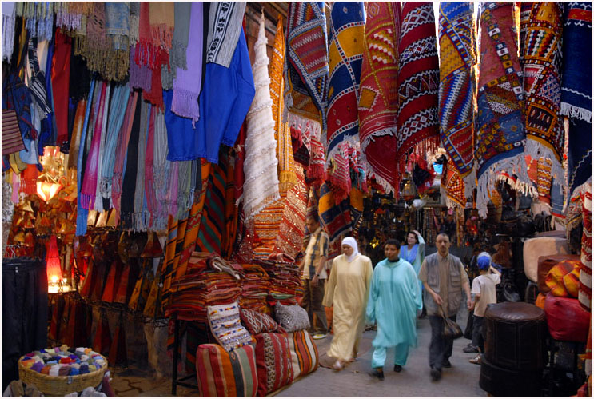

Slide 13
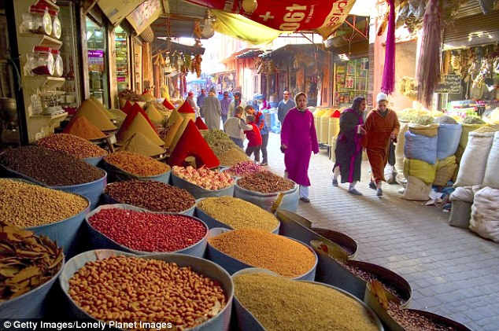

Slide 14
Culture of North Africa
-North African households are traditionally centered around males
-The workforce is primarily male
-Few women hold jobs after they marry

Slide 15
Culture of North Africa
-Times are changing throughout North Africa
-Polygamy is abolished, spouses can also seek divorce
-Preteen arranged marriages are outlawed
-Many women, especially in cities, are becoming employed

